Slide 1





EMPLOYEE
DATA ANALYSIS
PSYLIQ Internship Project
Created By: Divya Pardeshi

Slide 2




INTRODUCTION
The Employee Data Analysis project, conducted as part of my PSYLIQ Data Analyst Internship, focuses on leveraging Excel tools and techniques to analyze various aspects of employee data. The provided dataset contained 4000 employee records, and key tasks included creating pivot tables to summarize departmental headcount, applying conditional formatting to highlight performance issues, and calculating average satisfaction scores by gender. The project also involved visualizing work-life balance across job functions, analyzing termination patterns, and exploring the relationship between training metrics and performance. Ultimately, this analysis aims to provide actionable insights to enhance HR decision-making and improve overall workforce management.

Slide 3





Project Questions
& Solutions

Slide 4


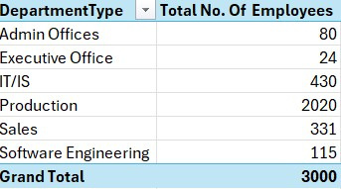



1. Can you create a pivot table to summarize the total number of employees in each department?

Slide 5
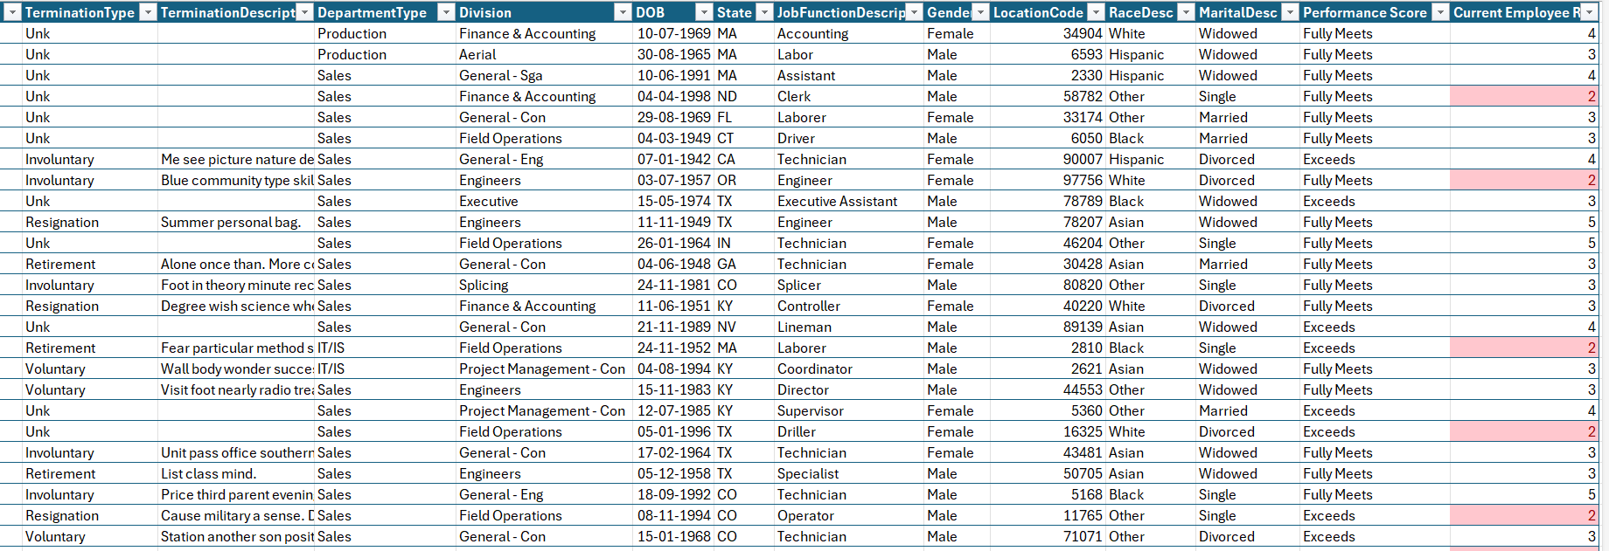

2. Apply conditional formatting to highlight employees with a "Performance Score" below 3 in red.

Slide 6
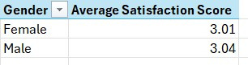

3. Calculate the average "Satisfaction Score" for male and female employees separately using a pivot table

Slide 7
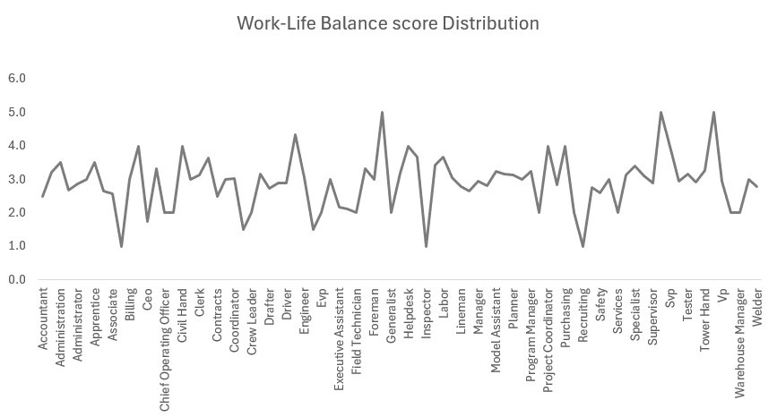
4. Create a chart to visualize the distribution of "Work-Life Balance Score" for different job functions.

Slide 8
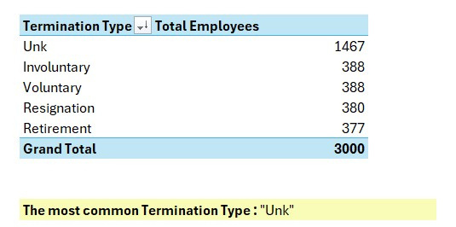
5. Filter the data to display only terminated employees and find out the most common "Termination Type."

Slide 9
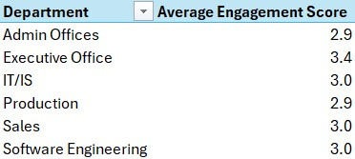

6. Calculate the average "Engagement Score" for each department using a pivot table.

Slide 10
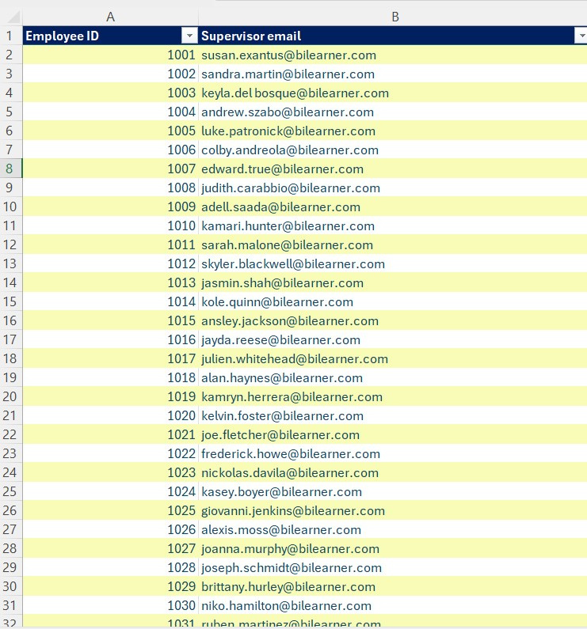
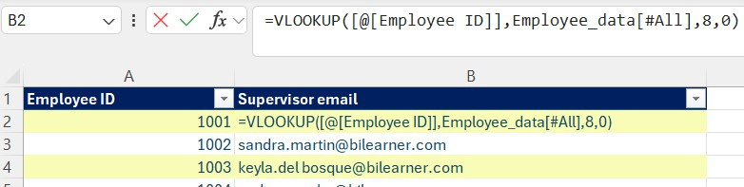

7. Use VLOOKUP to find the supervisor's email address for a specific employee.

Slide 11
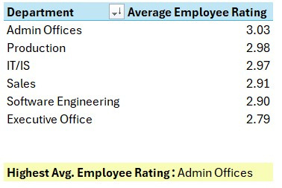
8. Can you identify the department with the highest average "Employee Rating?" to find the supervisor's email address for a specific employee.

Slide 12
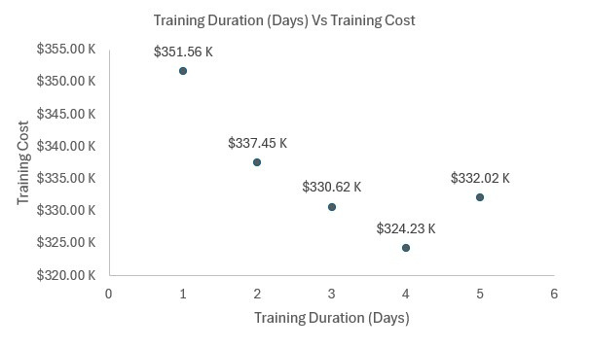

9. Create a scatter plot to explore the relationship between "Training Duration (Days)" and "Training Cost."

Slide 13
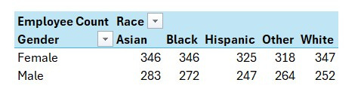

10. Build a pivot table that shows the count of employees by "RaceDesc" and "GenderCode."

Slide 14
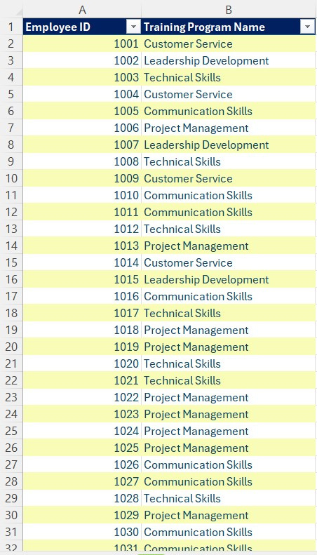
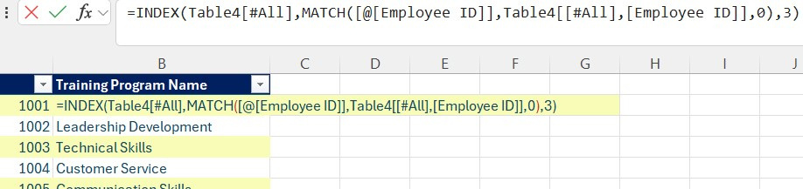
11. Use INDEX and MATCH functions to find the "Training Program Name" for an employee with a specific ID.

Slide 15
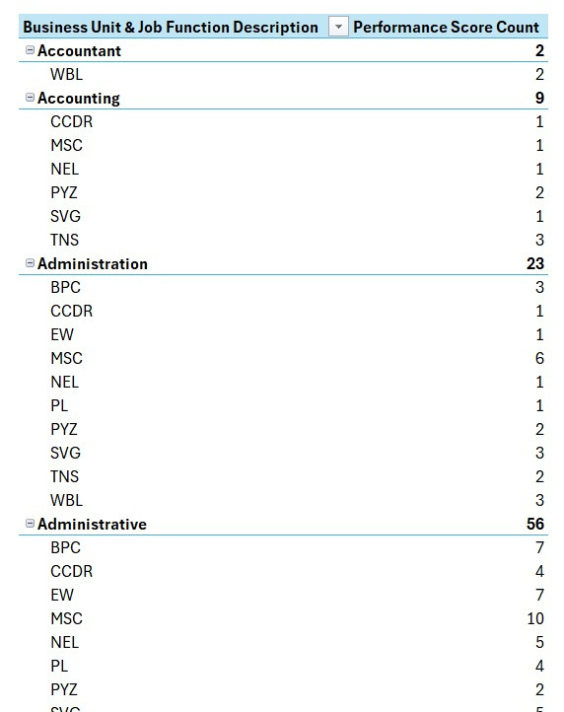

12. Create a multi-level pivot table to analyze the "Performance Score" by "BusinessUnit" and "JobFunctionDescription."

Slide 16
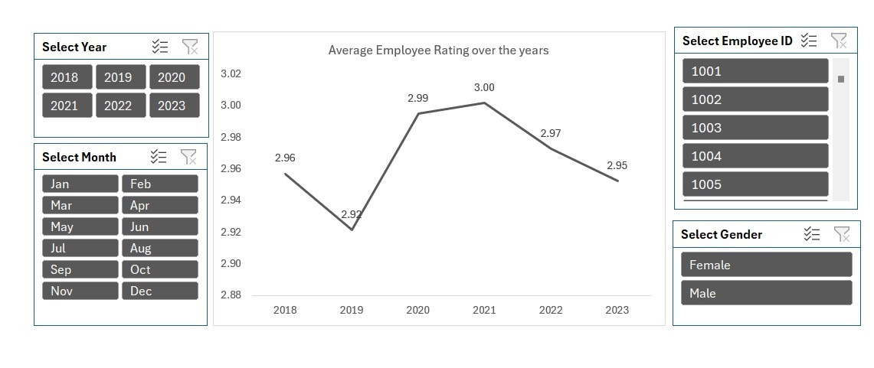
13. Design a dynamic chart that allows users to select and visualize the performance of any employee over time

Slide 17
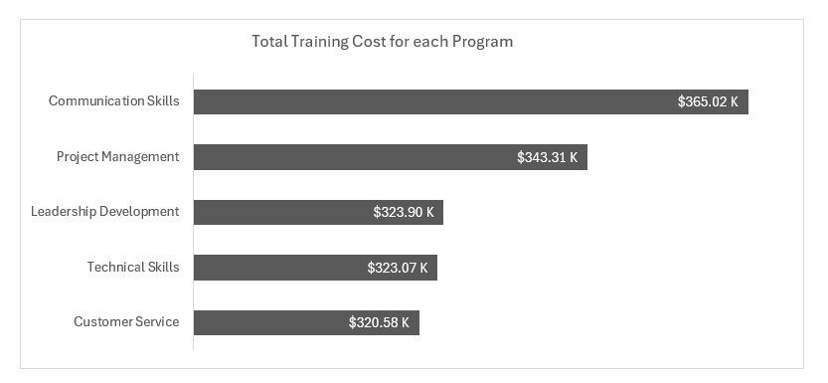

14. Calculate the total training cost for each "Training Program Name" and display it in a bar chart.

Slide 18
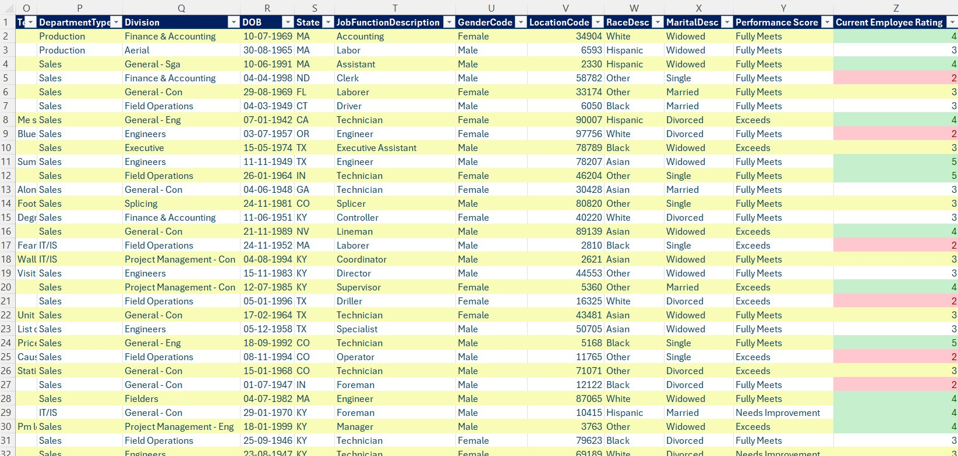
15. Apply advanced conditional formatting to highlight the top 10% and bottom 10% of employees based on "Current Employee Rating."

Slide 19
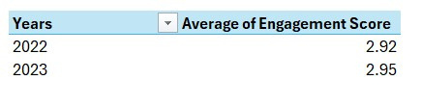

16. Use a calculated field in a pivot table to determine the average "Engagement Score" per year.

Slide 20
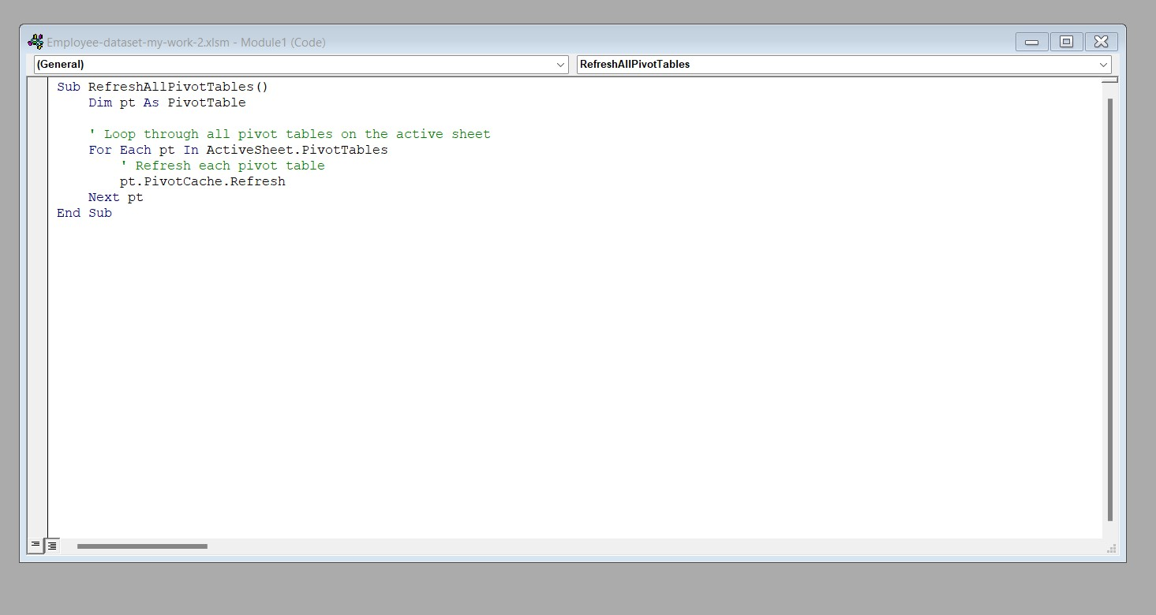

17. Can you build a macro that automates the process of updating and refreshing all pivot tables in the workbook?

Slide 21
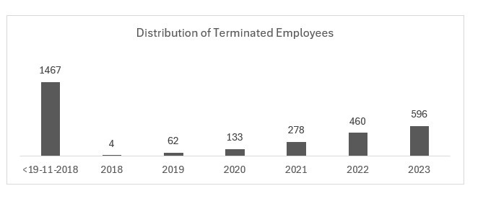
18. Create a histogram to understand the distribution of "ExitDate" for terminated employees.

Slide 22
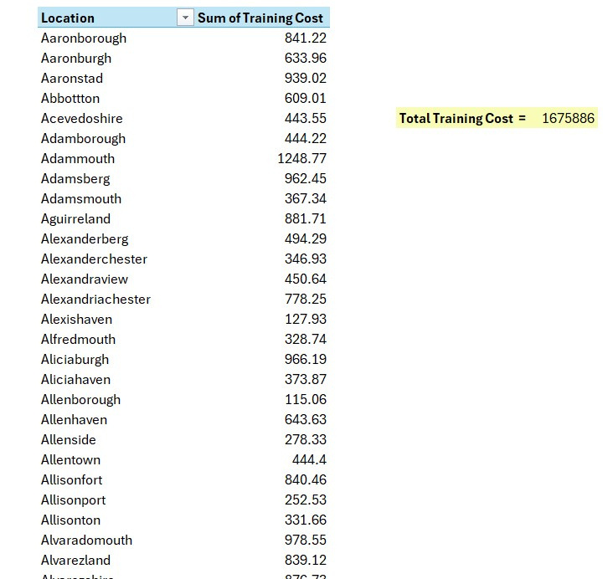

19. Utilize the SUMPRODUCT function to calculate the total training cost for employees in a specific location.

Slide 23
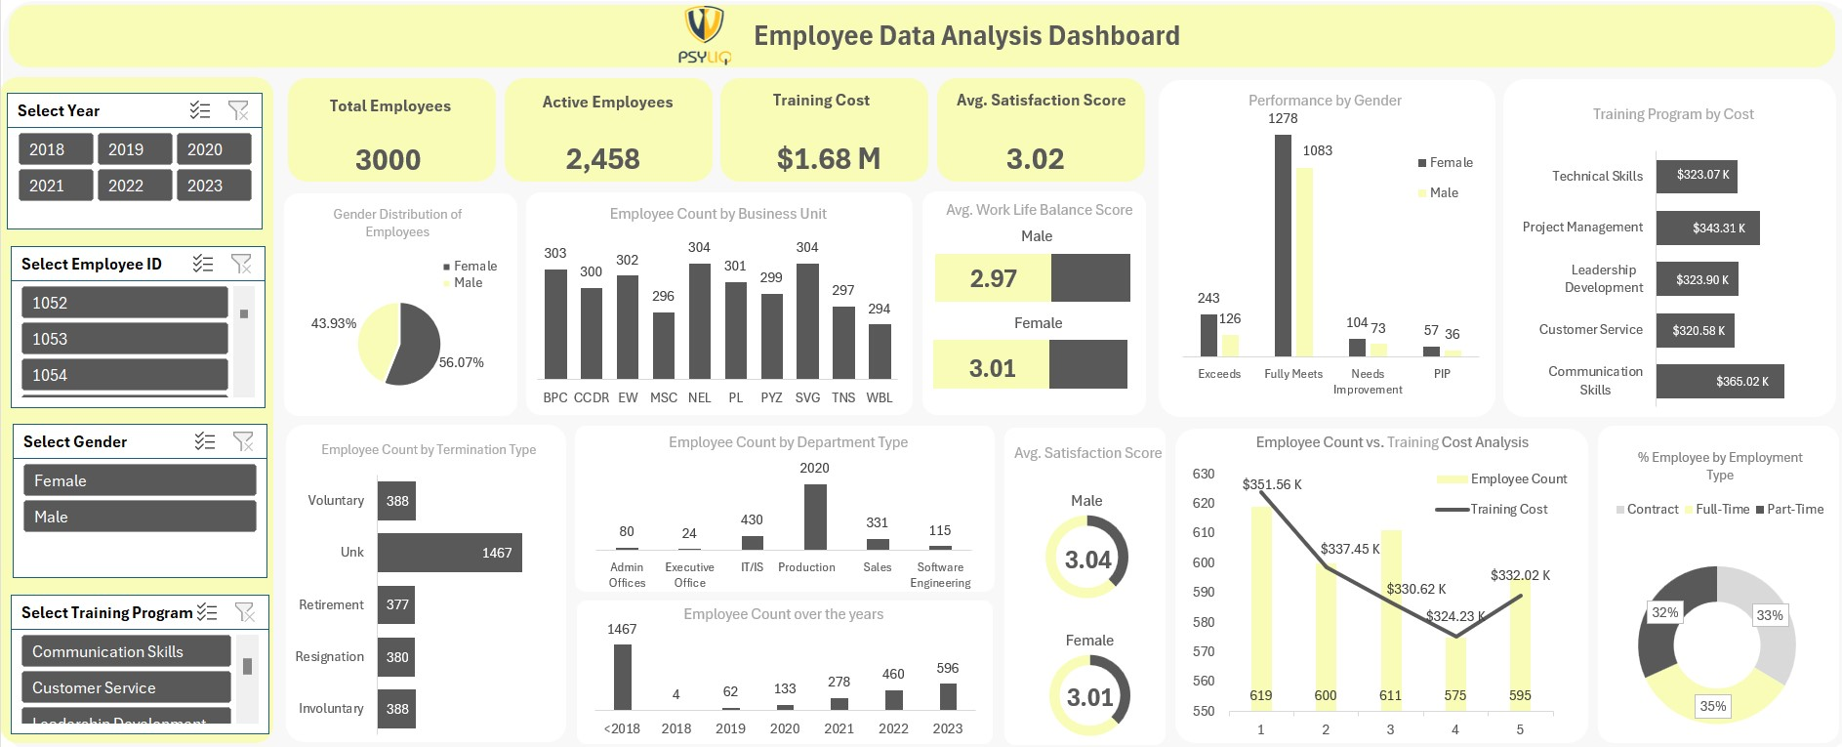
20. Develop a dashboard that provides an overview of key HR metrics, including headcount, performance, and training costs, using charts and pivot tables.

Slide 24

THANK YOU

